Slide 1
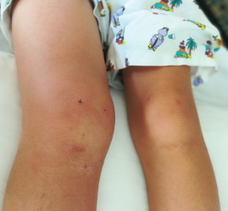
What is Juvenile Idiopathic Arthritis (JIA)?
Inflamed joints
Joint
Gut
JIA
Pain
Swelling
Restricted movement
Eye
Notes:
An estimated ~ 25,000 children, adolescents and young adults living with juvenile onset arthritis in UK

Slide 2
Why has precision medicine not (yet) become reality ?
Methotrexate
Response ?
add
biologic
Response ?
switch biologic
Response ?
Many trials do not embed biomarker discovery
Trial design aimed primarily at obtaining licenses;
Can blood provide biomarkers that reflect the inflamed tissue?

Slide 3




Right drug, right child , right stage of disease !
What we do now
What we need to do
A
Drug
B
C
D
Trial and error prescribing
Everyone gets Drug A
Precision targeting

Slide 4
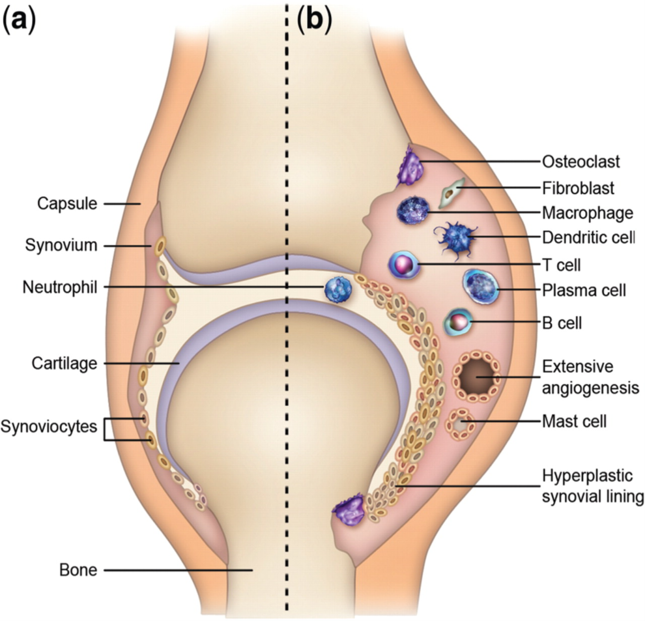
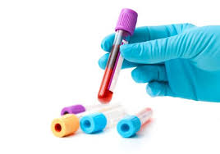
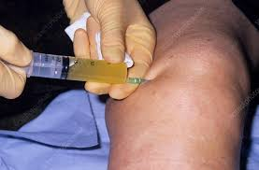
How can we address this problem now?
‘the truth is in the tissue’
How do we investigate?
Blood
Synovial
fluid

Slide 5
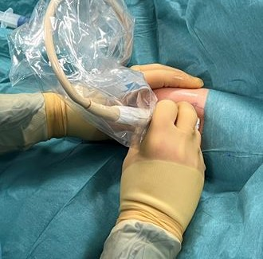
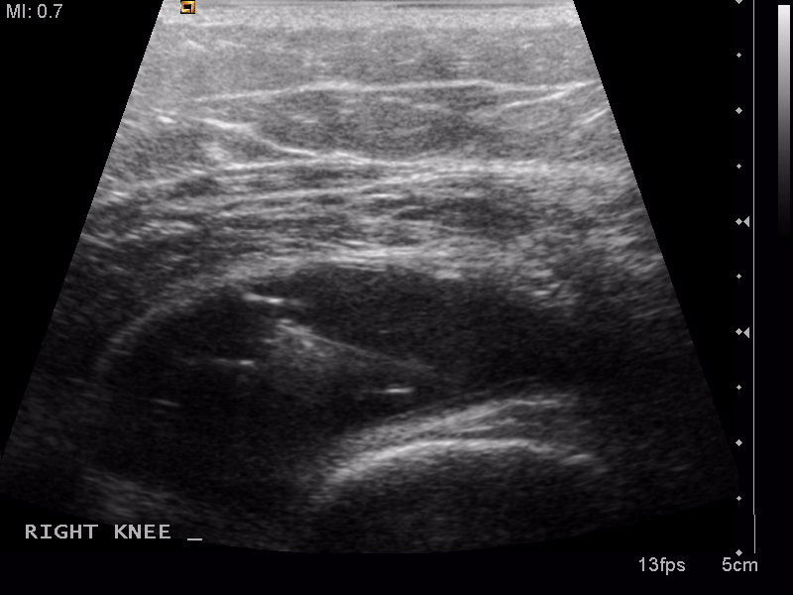
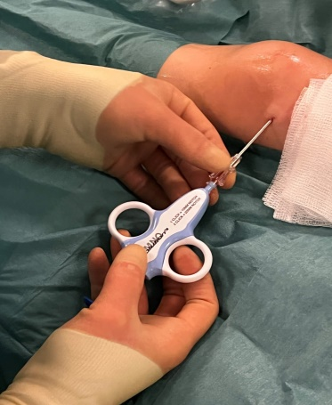
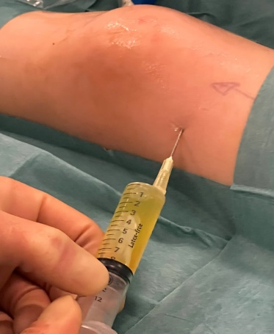

Minimally invasive synovial tissue biopsies
Diagnosis, treatment naïve
Adulthood
Synovial tissue biopsy
Matched blood + fluid
Clinical
Over 60 cases recruited for biopsy
Safe, acceptable + well-tolerated
Longitudinal samples
Synovial pathology linked to long-term outcomes
Notes:
World first tissue based study to understand tissue pathology linked to clinical outcomes
Pioneered the application of a safe, acceptable and well tolerated minimally

Slide 6
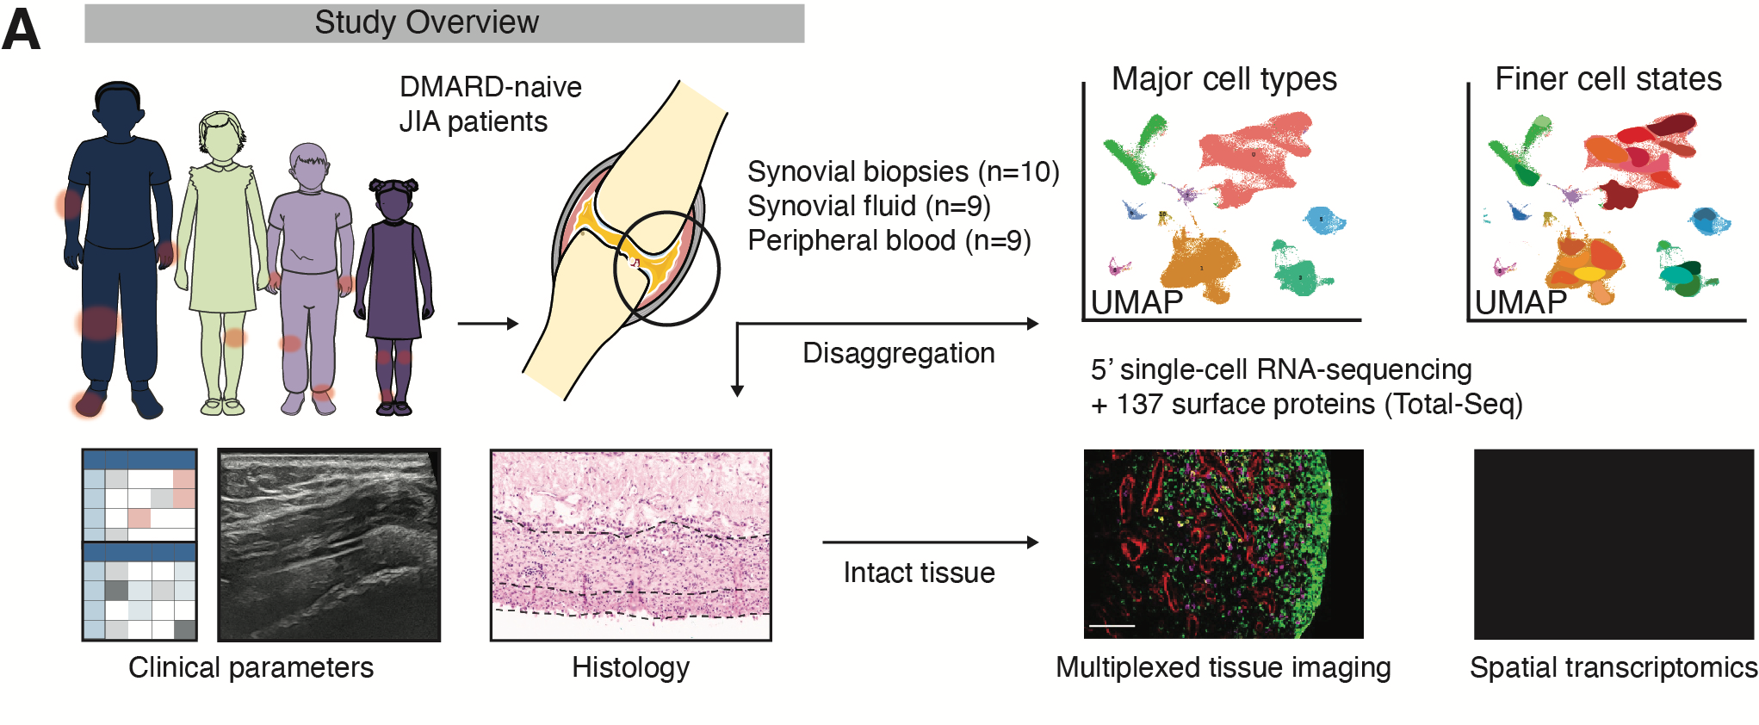
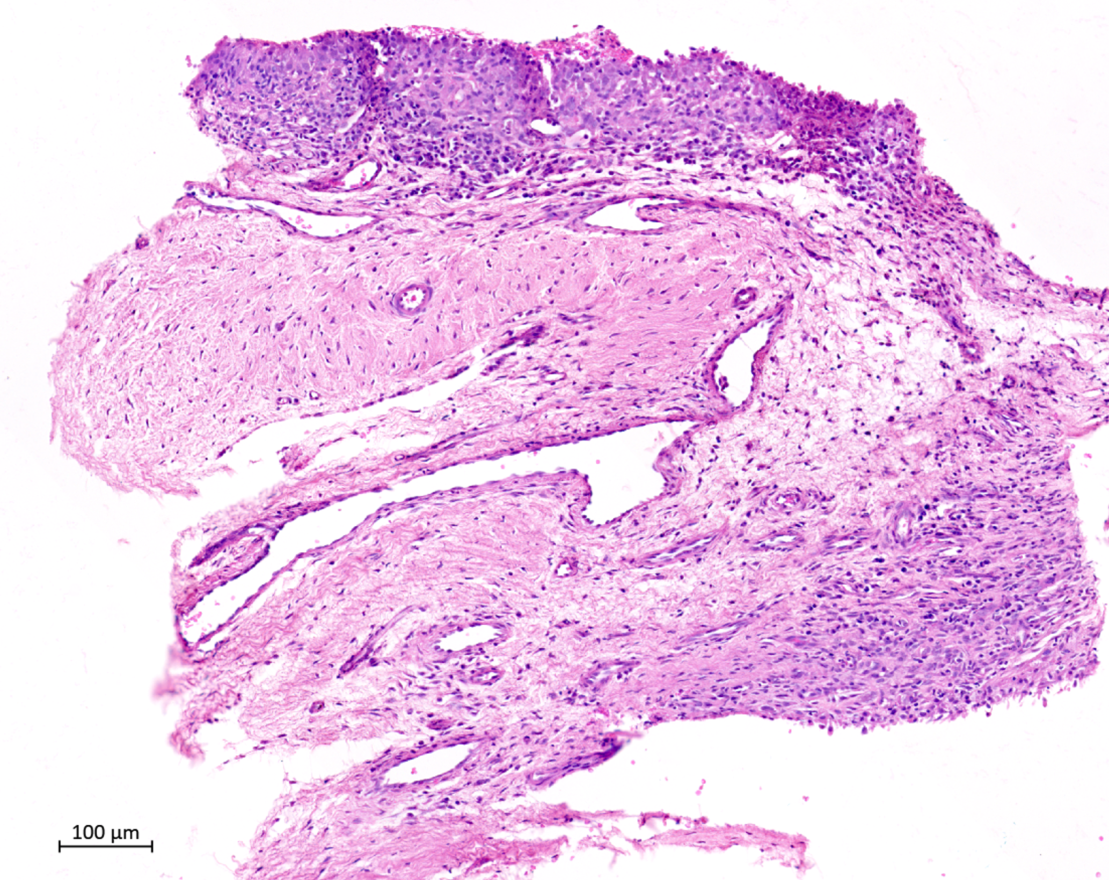
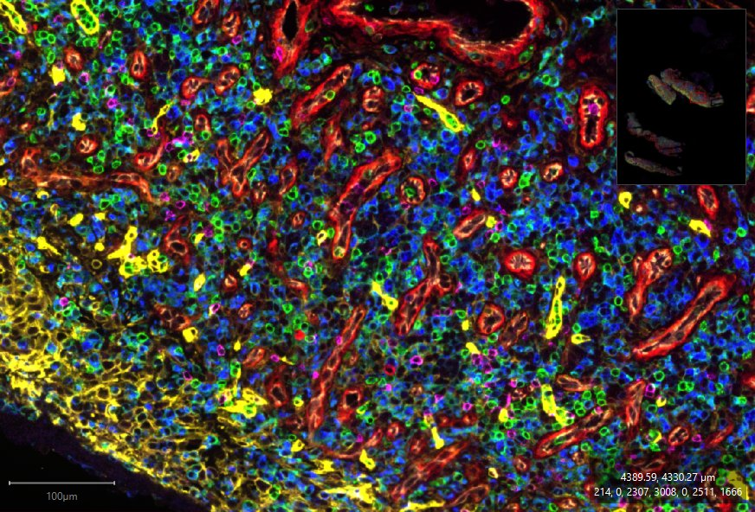
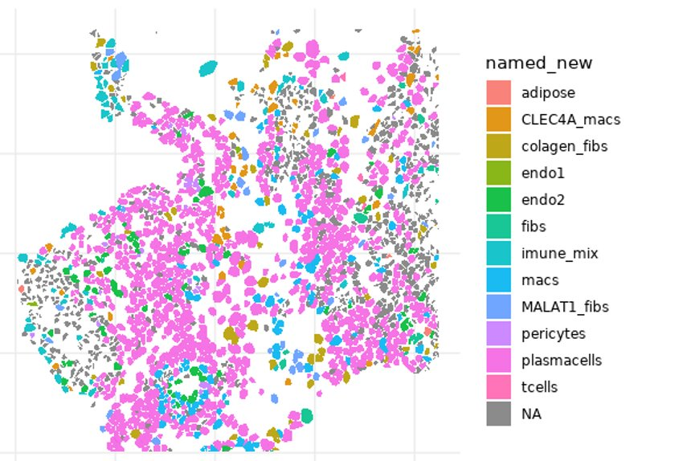

Multiomic Analysis of Paediatric Joint and Gut Inflammation (MAP-JAG) Study
Notes:
Capacity to perform high resolution tissue analytics
Optimized, refined and applied these technologies to the inflamed joint in JIA
(FUNDING FOR SPATIAL AND SINGLE CELL ANALTICS – TISSUE ATLAS – Predictive models in oJIA)

Slide 7
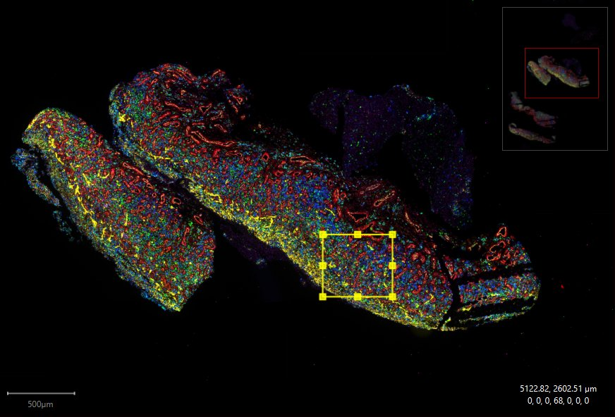
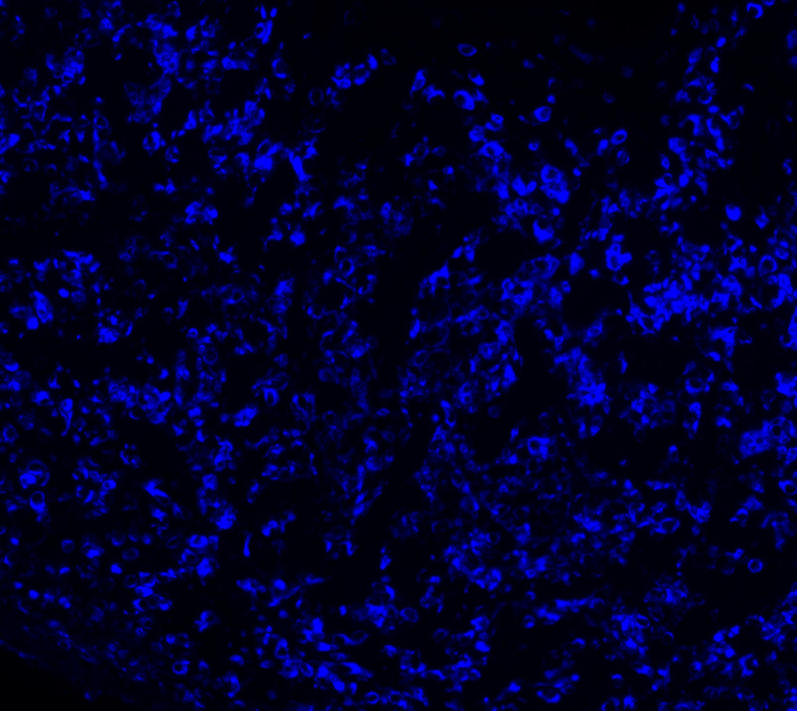
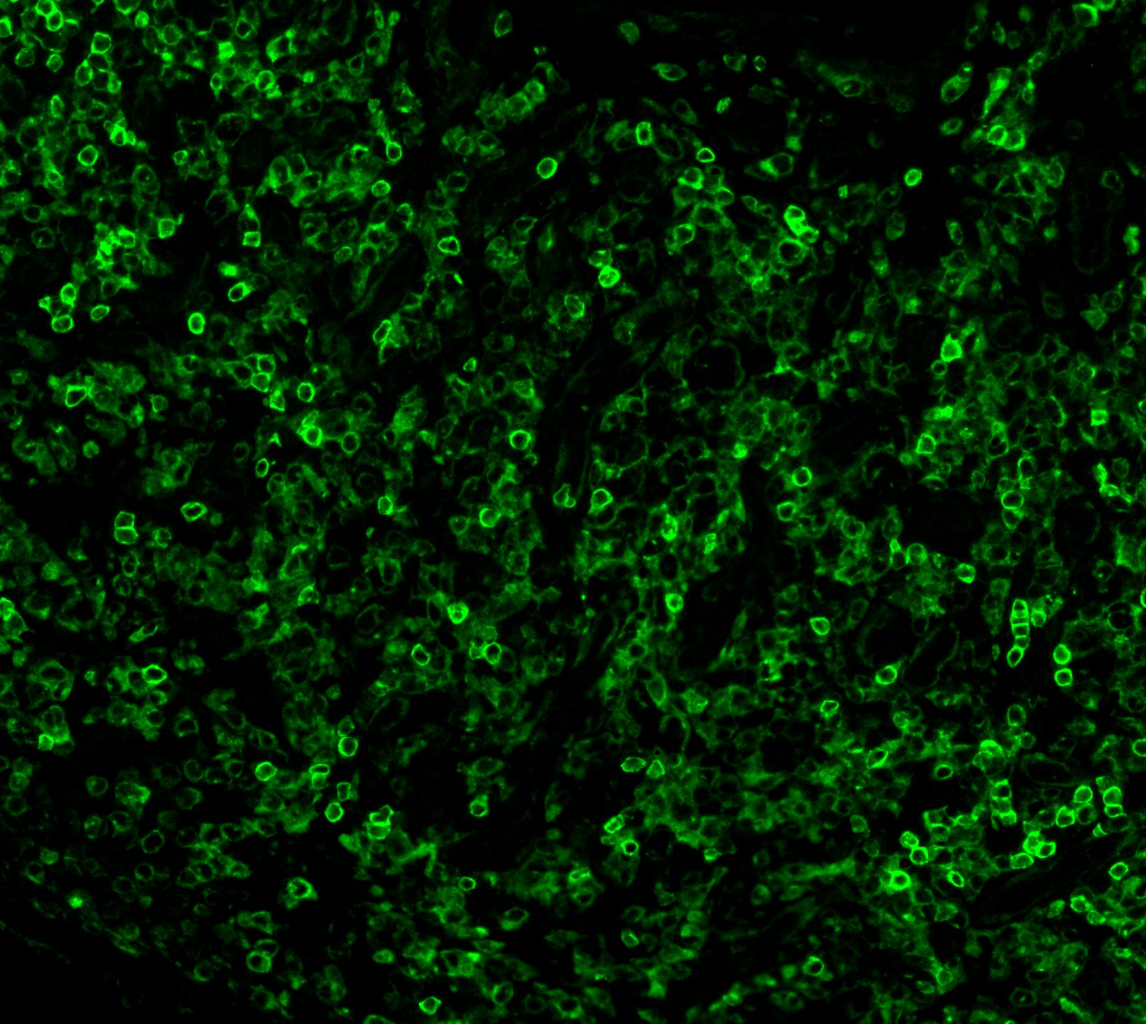
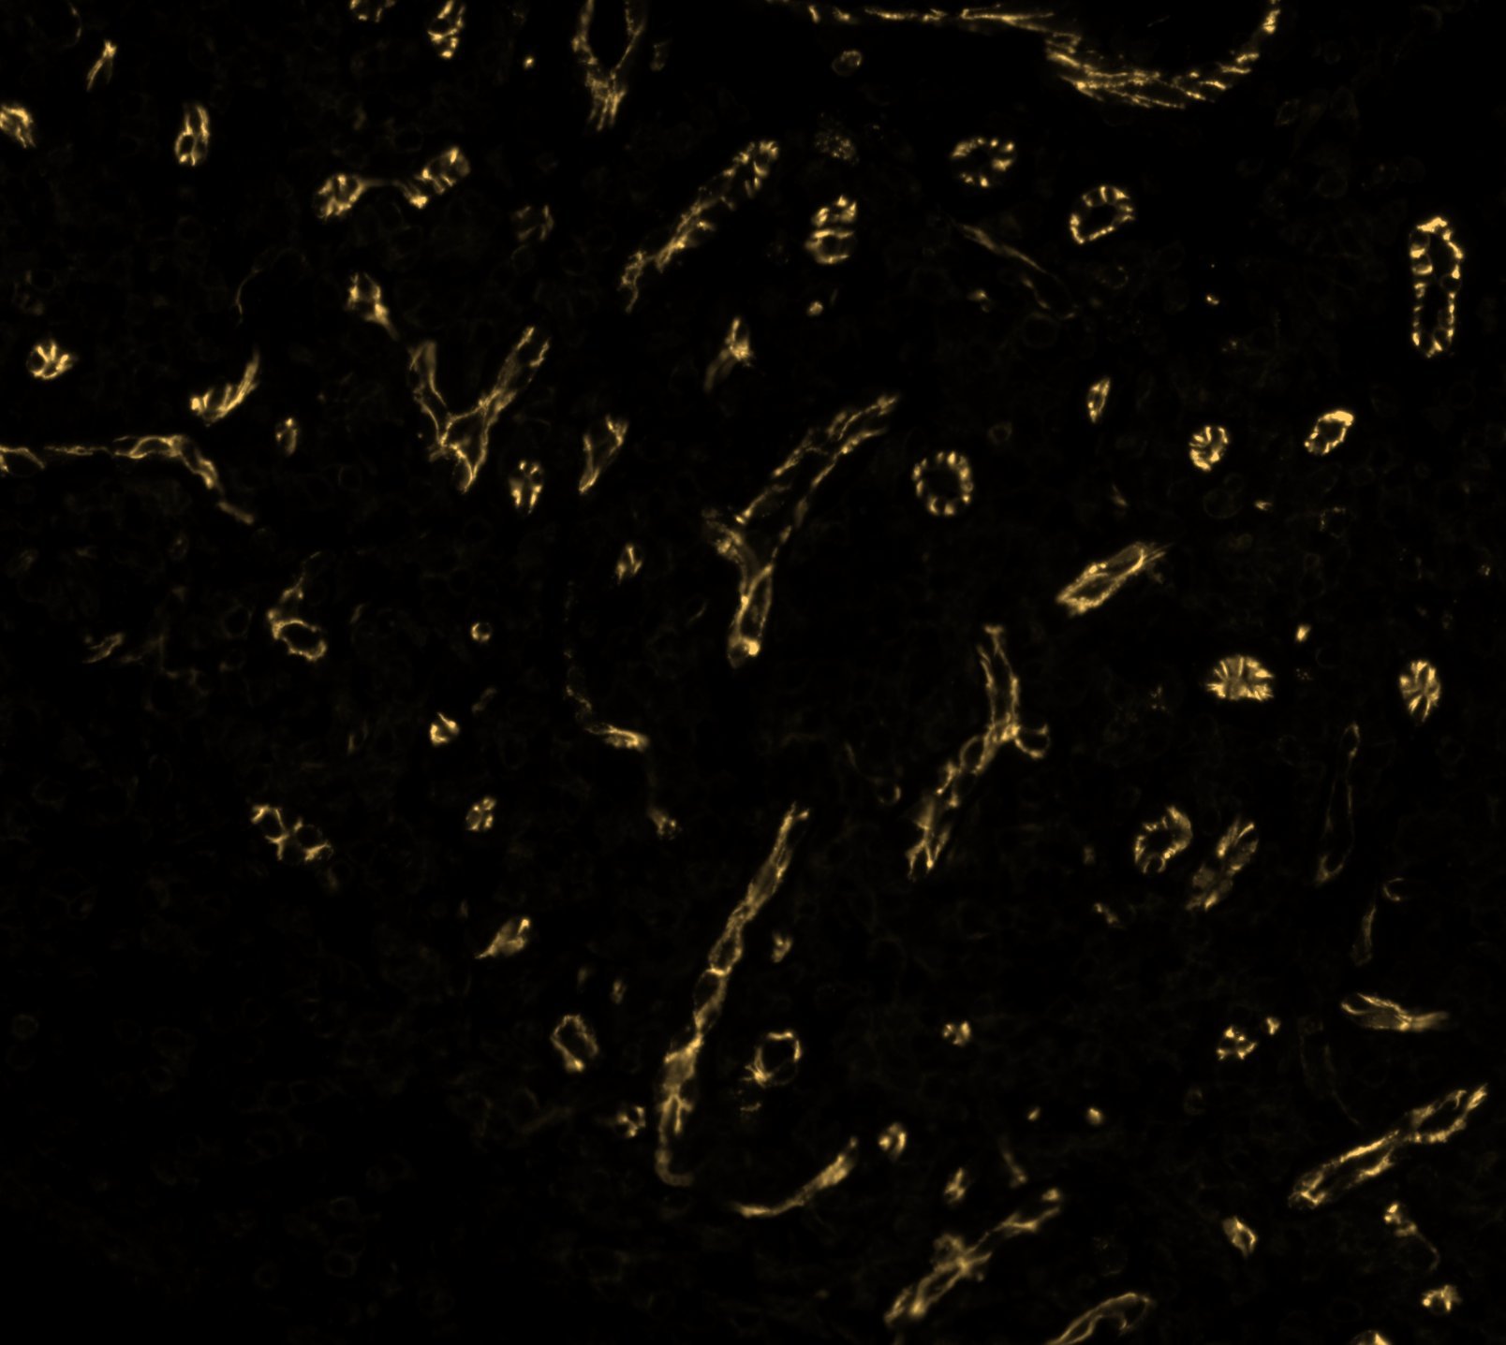
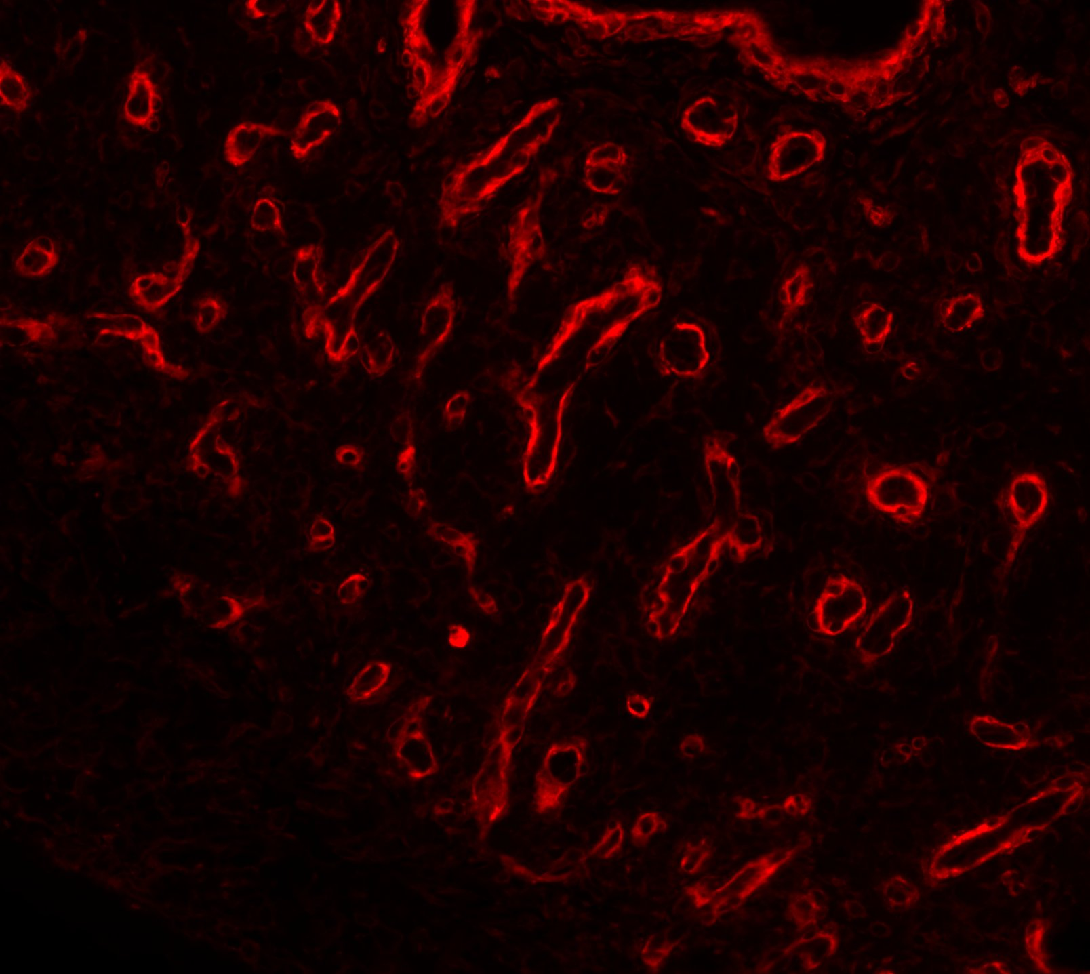
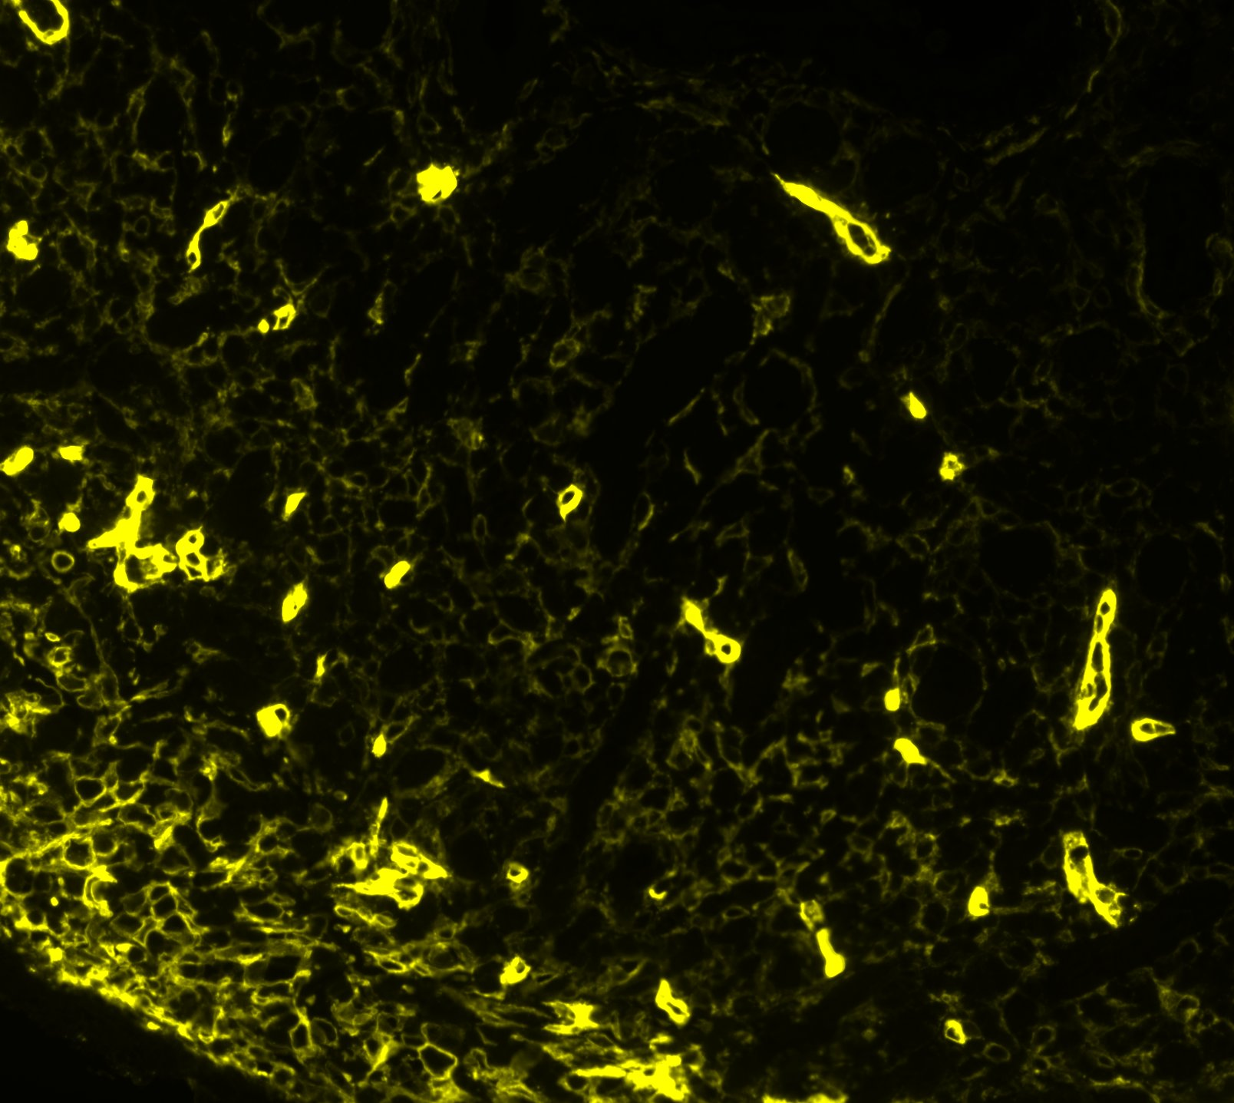
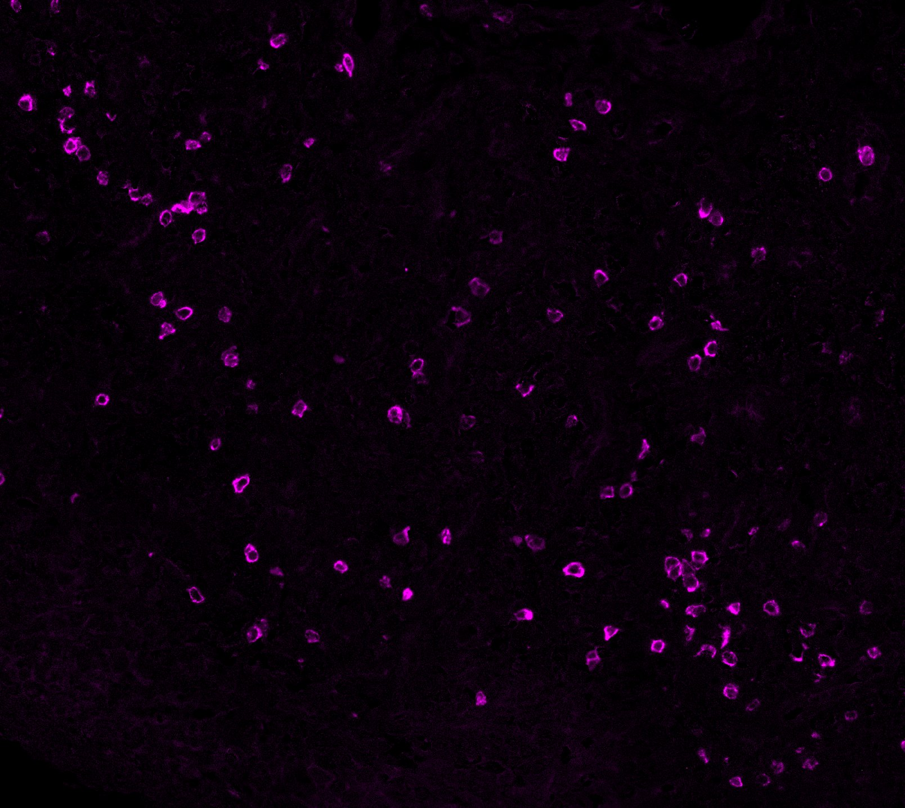
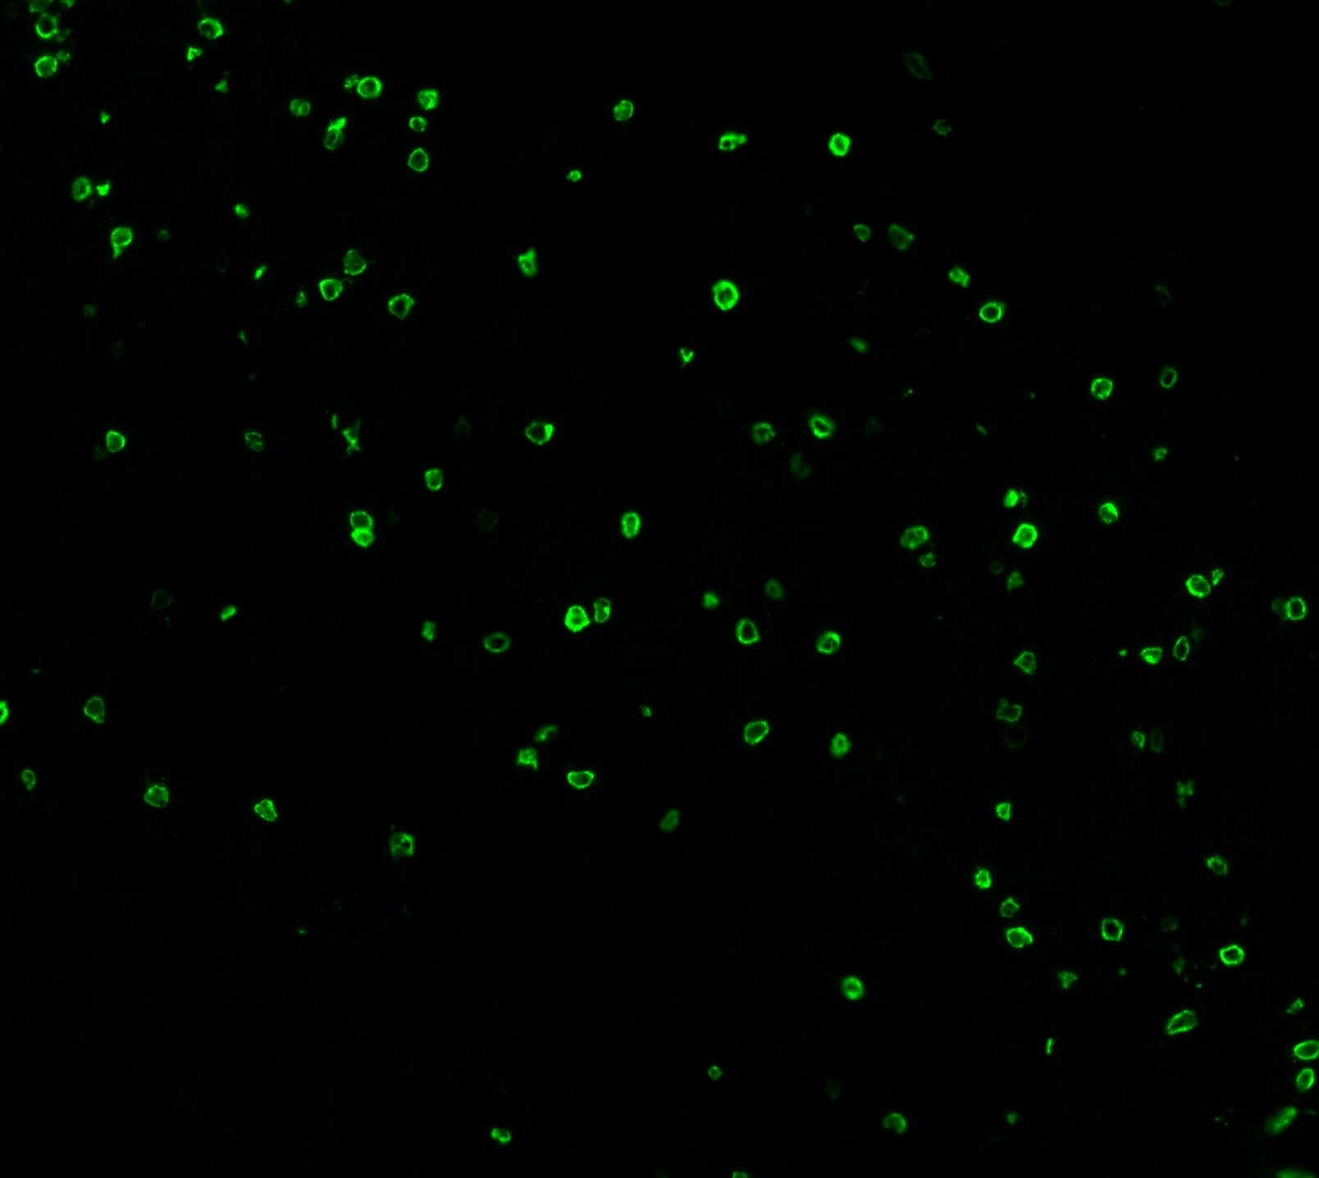
Synovial tissue biopsy
CD68
CD4
CD20
CD8
CD31
CD90
PDPN

Slide 8

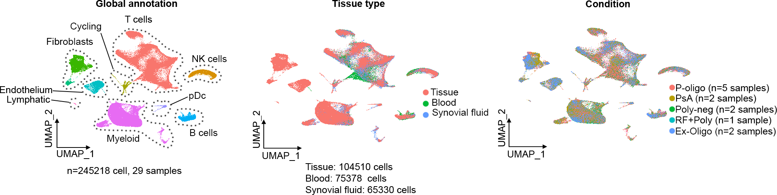
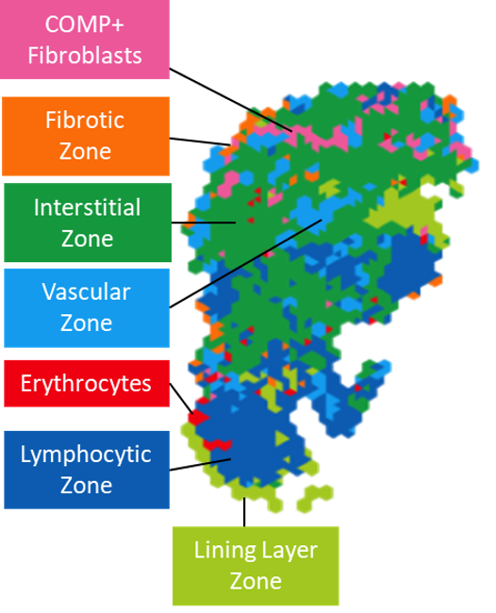
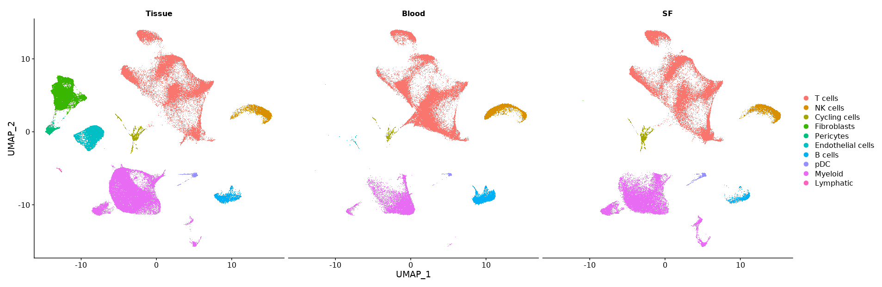
Synovial tissue analysis in JIA
245,218 cells in 11 patients
Spatial tissue analysis in 11 matched patients
27 Biopsies in 33 patients recruited
Tissue
104510 cells
Blood
75378 cells
Synovial fluid
65330 cells

Slide 9

We need to design better trials
Learning from every child in a clinical trial
Drug targeting pathway A
Analysis of clinical outcome
Standard of care
Analysis of outcome linked to cellular pathology
Wedderburn et al, ARD, 2022

